Slide 1

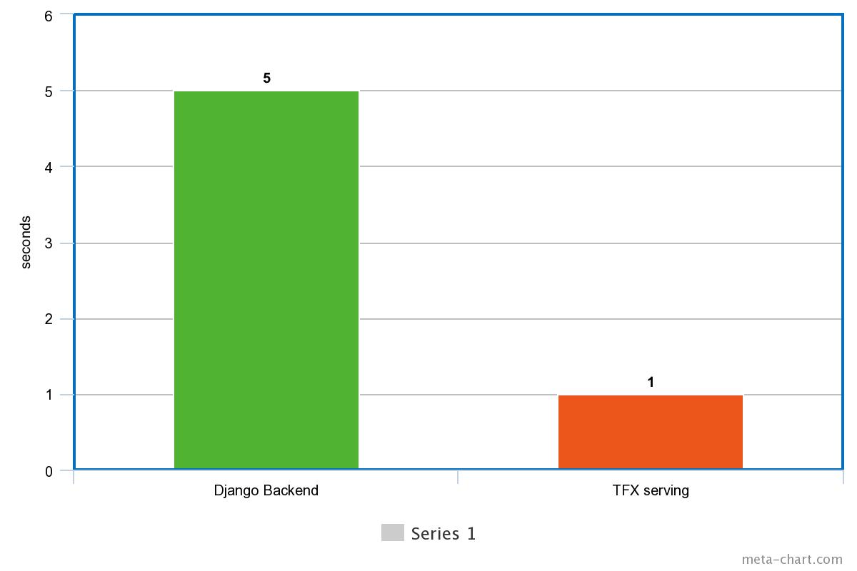
Why TensorFlow serving?

Slide 2
Creating your own serving image

Slide 3
Steps
docker run -d --name serving_base tensorflow/serving
docker cp models/<my model> serving_base:/models/<my model>
docker commit --change "ENV MODEL_NAME <my model>" serving_base <my container>
Run the model:
docker run -p 8501:8501 <container name>

Slide 4
Dockerize Web Application
Dockerfile
FROM python:3.6 ENV PYTHONUNBUFFERED 1 RUN apt-get update RUN apt-get install 'ffmpeg'\ 'libsm6'\ 'libxext6' -y
RUN mkdir /app WORKDIR /app ADD . /app/ RUN pip3 install --upgrade pip RUN pip install -r requirements.txt EXPOSE 8000 CMD ["python", "manage.py", "runserver", "0.0.0.0:8000"]

Slide 5
Upload To Docker Hub
docker push dockerRepo:latest

Slide 6
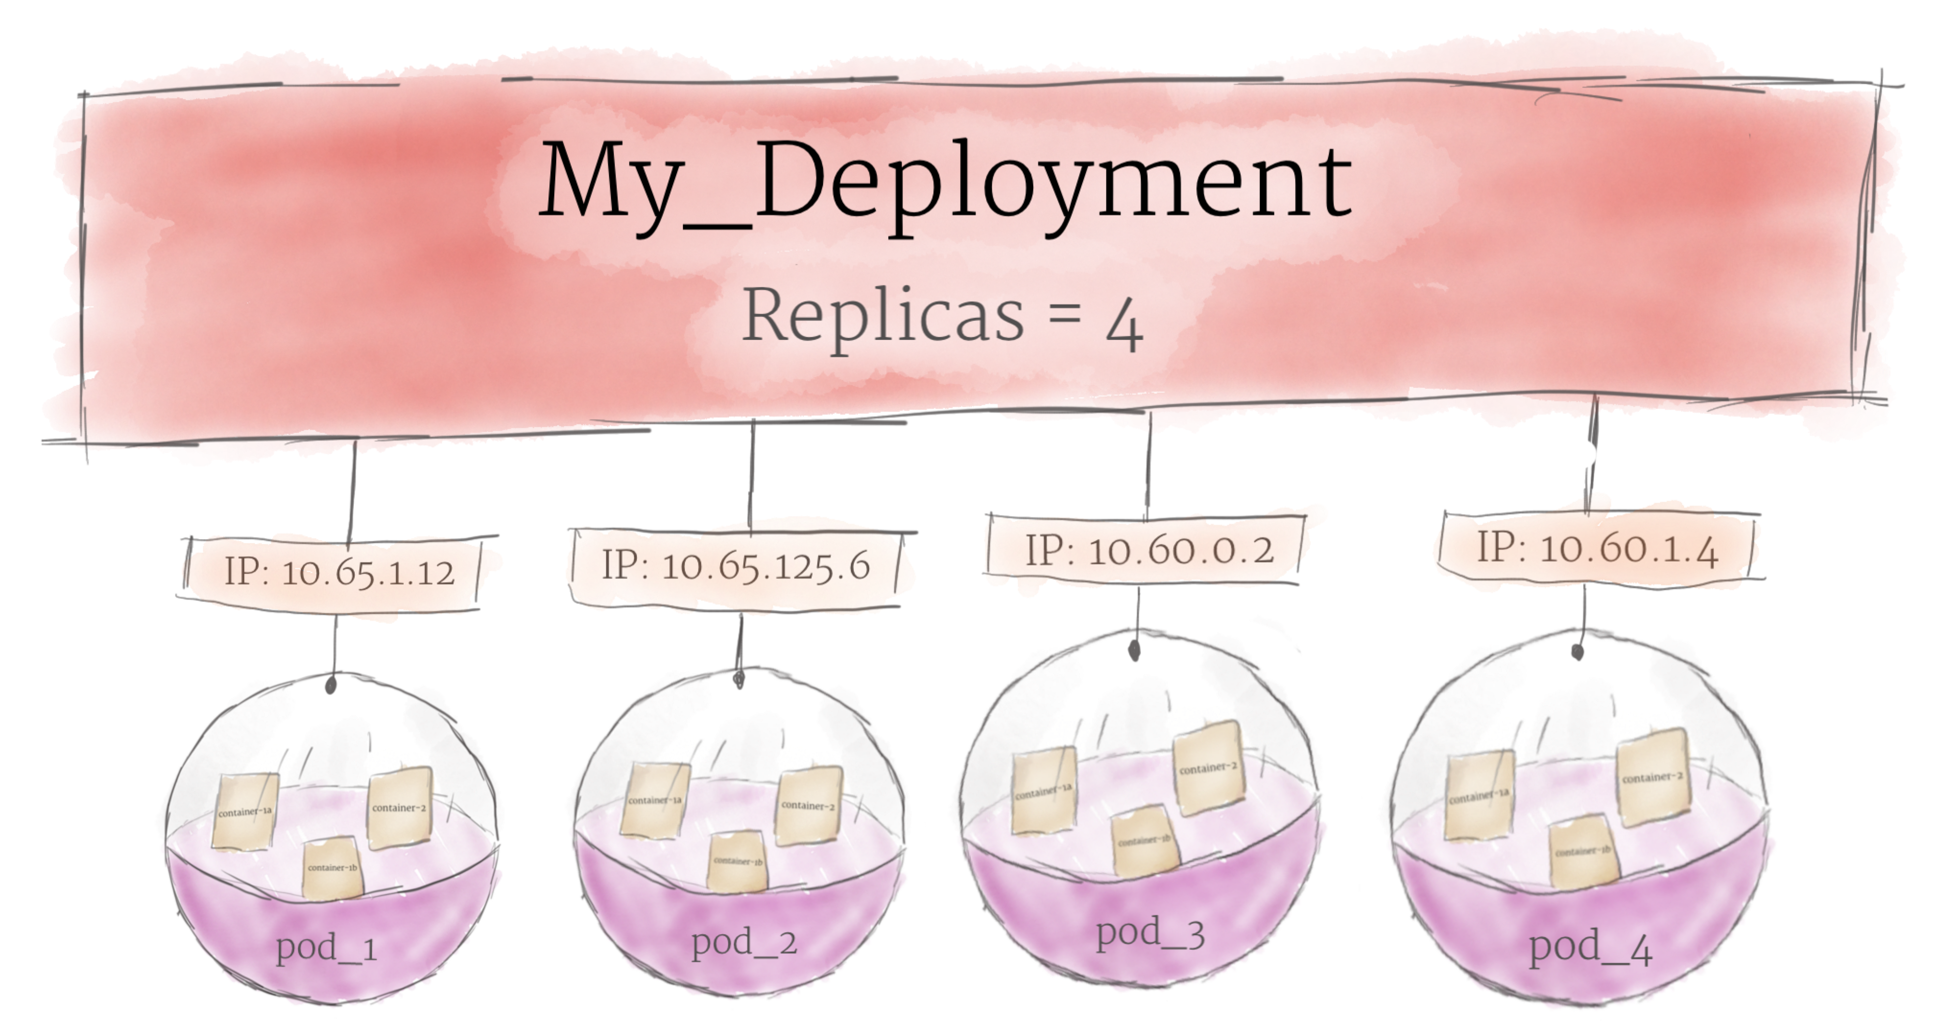
Kubernetes
Using Kubernetes Engine on GCP.
kubectl create deployment --image lokv007/dldjango:latest django
To expose the service,
kubectl expose deployment django --type=LoadBalancer --name=my-service-app –port 8000

